Slide 1
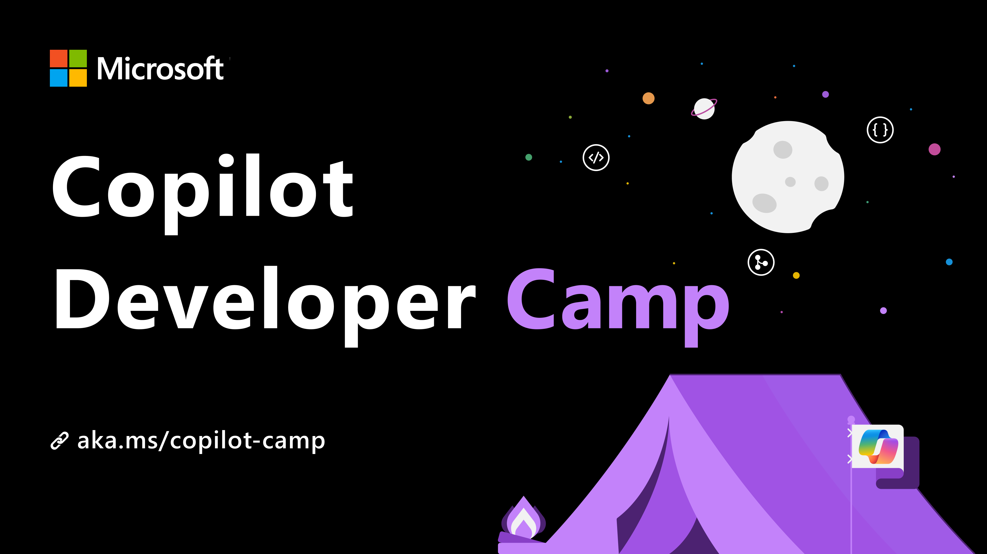

Slide 2
Building Microsoft 365 Copilot Agents
Notes:
Welcome!
On September 16, Satya Nadella and Jared Spataro announced Wave 2 of Microsoft 365 Copilot.
One of the big things they announced was the idea of Copilot Agents; in this presentation you’ll learn how to build these agents.
This presentation is focused on professional developers – that is, people who work in an IDE like Visual Studio Code or Visual Studio; people who are comfortable with programming languages and GitHub; people who want to build scalable, multi-tenant solutions with a controlled software development lifecycle. There is a wonderful tool for “low-code” developers or makers called “Copilot Studio” that can do similar things, but this isn’t a presentation about Copilot Studio.

Slide 3
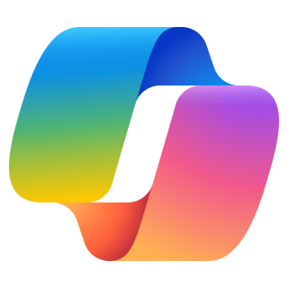

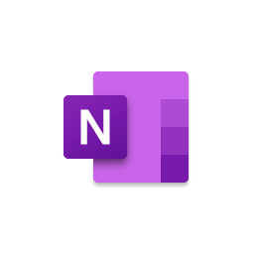







Microsoft 365 Copilot
Natural Language
Large Language Models
The Internet
Microsoft Graph - Your Data -
Microsoft 365 Apps
Notes:
But first let’s take a step back. (Ask audience how many have used Microsoft 365 Copilot; explain as needed)
Let me take a moment to point out some of the new features you may not have seen yet – specifically how Copilot agents interact with end users, just to level set.

Slide 4
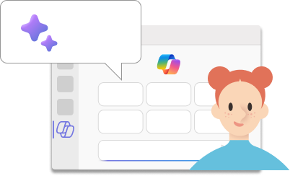

You can ask Copilot for Microsoft 365 to:
Summarize chat conversations in Teams from the past n days
Draft email messages
Create a meeting agenda, based on the past meetings
Draft a project proposal based on data from your documents and spreadsheets
…and so on!
Copilot clients:
M365 Chat
Teams
Outlook
Word
PowerPoint
Excel…
Notes:
Here are some examples of how people use Microsoft 365 Copilot out of the box
But here you will learn how to go beyond that and build Copilot agents that are specific to your business.

Slide 5





Microsoft 365 Apps
Microsoft 365 Service Boundary
Response
+
app commands
Customer data is not stored or used to train the model
Azure OpenAI
instance is maintained by Microsoft. OpenAI has no access to the data or the model.
1
6
Large Language Model
“What are the milestones for Project Falcon”
User prompt
Modified prompt
Azure OpenAI
Pre-processing
3
2
4
RAI
Microsoft Graph
Grounding
3
LLM Response
RAI is performed on input prompt and output results
5
Microsoft 365 Copilot
Semantic
Index
Grounding
Data flow ( - all requests are encrypted via HTTPS and wss://)
Post-processing
1
Your context and content
emails, files, meetings, chats,
calendars, and contacts
User prompts from Microsoft 365 apps are sent to Copilot
Copilot accesses Graph, (optional) web + other services for pre-processing
Copilot sends modified prompt to Large Language Model
Copilot receives LLM responses
Copilot accesses Graph for post-processing
Copilot sends the response, and app command back to Microsoft 365 apps
2
3
4
Customer Microsoft 365 Tenant
5
6
Notes:
The first thing is, I ask a question which is the user prompt. And I can do this across any of the copilots in Microsoft 365 apps. This prompt gets sent to the copilot orchestration engine. The orchestration engine is what powers all of our copilot scenarios. It doesn't just send the question directly to the LLM.
The first step is, which is very important piece, which is pre-processing. This is where orchestrator does grounding, grounding is the way where we get enough information to answer the question accurately. It’s a big part of how we don’t hallucinate.
And the way it gets more information is by calling Microsoft Graph. So copilot only has access to what the user has access to. Admins can also further apply additional permissions from the source system to M365 copilot as well.
All of the indexing on relationship, relevance, ranking of the content is done through Semantic Index. It's a sophisticated map of all data and content in your organization to enable copilot to deliver more relevant responses..
Once the orchestration engine says I have enough information to answer the question. It takes your question, the additional grounding data and sends it in a modified prompt to the LLM to give the LLM enough information to generate a response.
The LLM will generate a response, and the next step, which is another very important step, which is the post processing step. We do additional grounding where we call Microsoft graph, validate the responses are accurate. Make sure we have the right references and citations, and also check the response isn’t generating harmful content and is still maintaining our commitment to being ethical and fair.
Once the orchestration engine decides that there’s enough to give a good response. It responds back to the App.
This is a very linear flow. The orchestration engine is an iterative process, it could call the graph multiple times, can call multiple other skills.
None of the prompts, responses data is used to train the LLMs. Data generated remains within your company's tenant, and complies with your existing compliance, security, identity, privacy policies. All of this flow happens within the M365 compliance boundary and you see the LLMs are also private instances within the Microsoft 365 compliance boundary.
This is flow is a pretty simple flow where you saw the orchestration engine gets some additional grounding data from Graph, but what I love, and it’s the purpose of this sessions, is that you can make the orchestration engine more powerful by customizing it, and connecting it with additional grounding data with graph connector, and adding more functionalities like plugins.

Slide 6
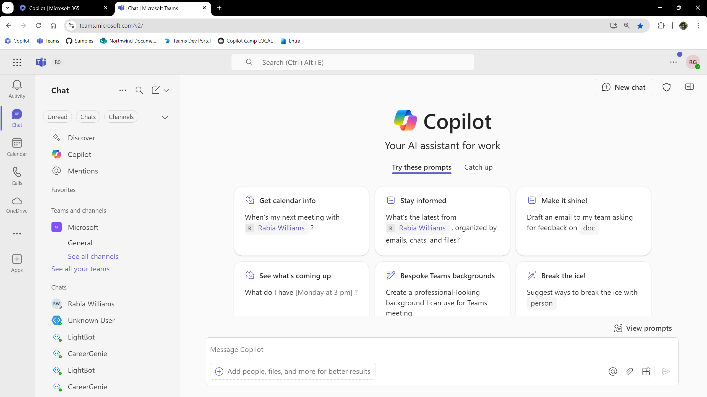
Open panel
BizChat
Notes:
First a bit of terminology.
This familiar view of Copilot is called “BizChat” – it’s the chat user interface used by Microsoft 365 Copilot across all the applications (Teams is a hybrid at the moment)
Now you can open a panel to see the available agents.

Slide 7
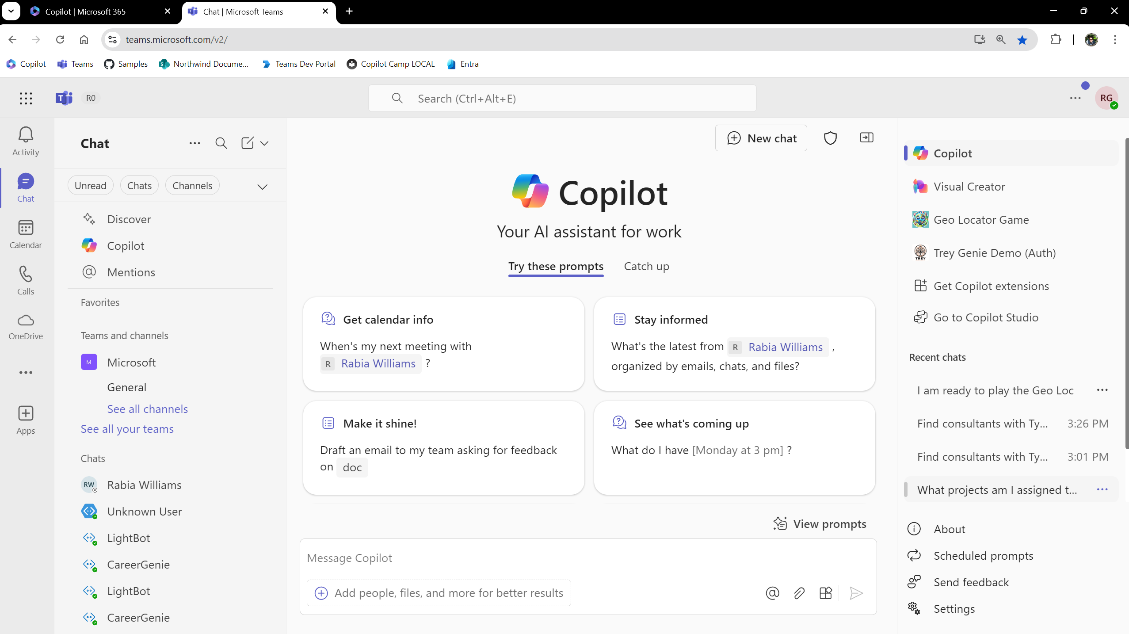
Agents
Notes:
Here are the agents. You can click one to get the “Immersive” experience.

Slide 8
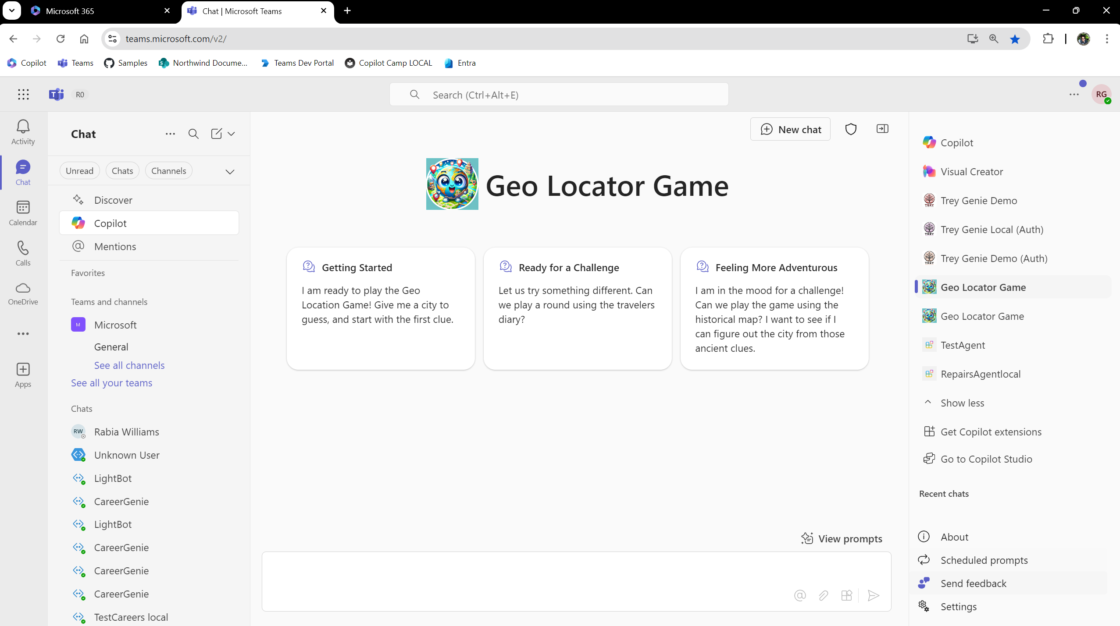
Immersive experience
Notes:
In the immersive experience the agent has its own branding and prompt suggestions. Users can speak to it as they would speak with a human expert.

Slide 9
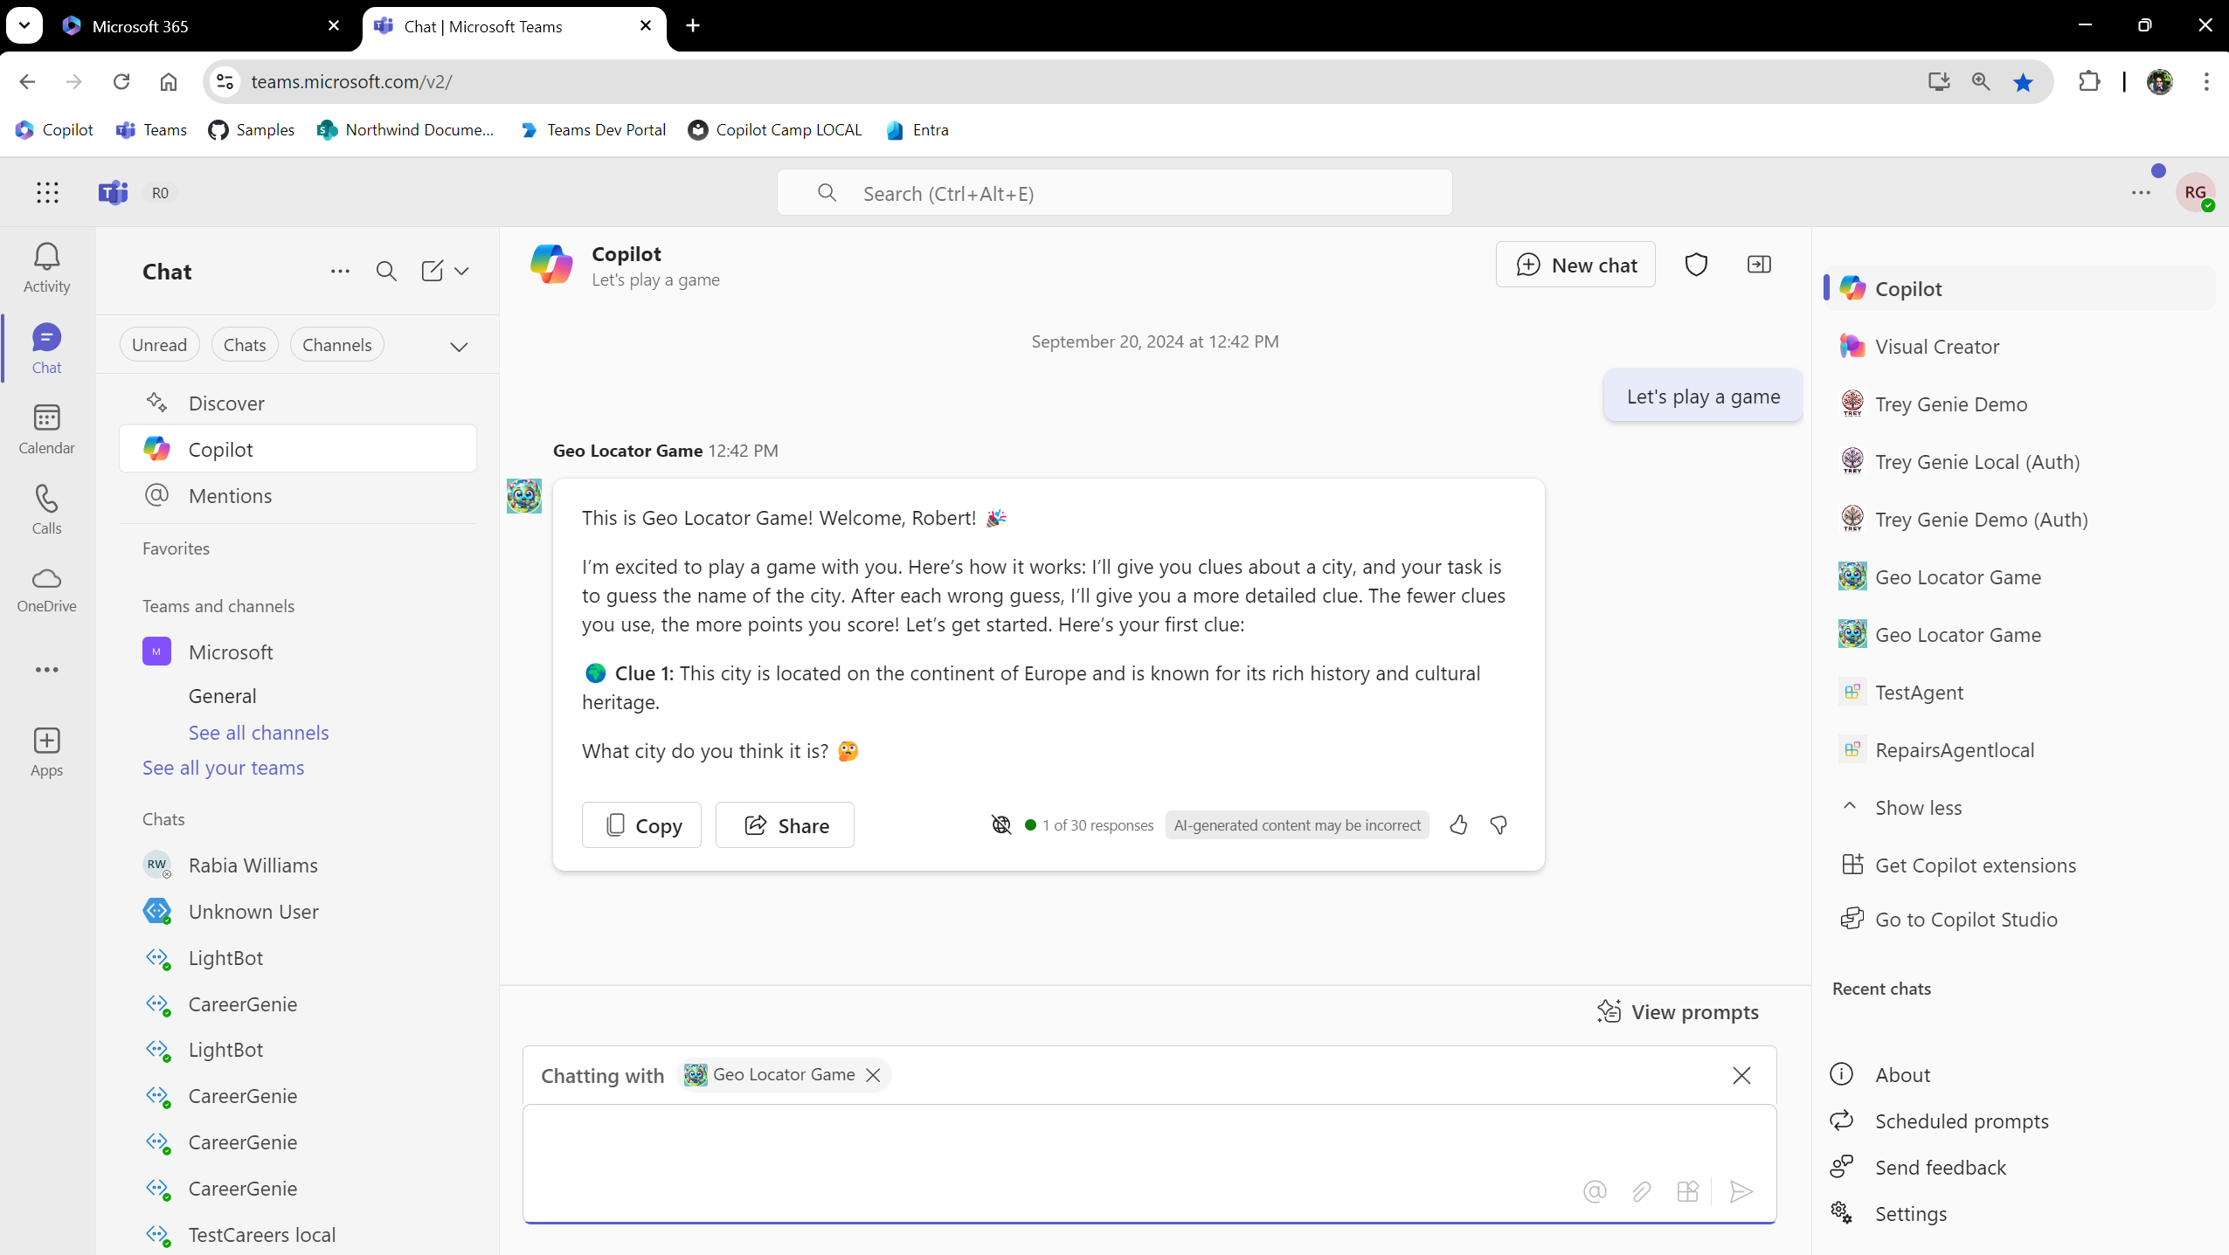
In context experience
Notes:
You can also @ mention an agent to bring it into conversations and into the general Bizchat UI. This is called the In Context experience.

Slide 10
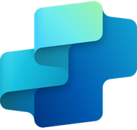

Copilot Agents
Extend Microsoft Copilot
Build your own agent
Declarative Agents
Custom Engine Agents
Low & pro-code
Copilot
Studio
Visual Studio
Code
Notes:
You can “extend” by adding your own agents on top of Microsoft 365 Copilot. That means the AI and orchestration is part of Microsoft 365 so you don’t need to worry about it. These are called Declarative agents.
Or you can “build” your own AI agents, called Custom engine agents. This is where Microsoft 365 presents your custom chatbot in the Bizchat UI. You control everything – and your responsible for it all as well – you might use AI models in Azure AI Studio along with your own code running in Azure app services.
These solutions can be developed by what we’re calling “pro devs” – the code jockeys among us – or using a low code tool called Copilot Studio.
I’m going to show you the Pro dev option using Visual Studio Code and a free extension called Teams Toolkit, however most of this can be developed with any tools that can create JSON and Zip files and create an HTTP web service.

Slide 11
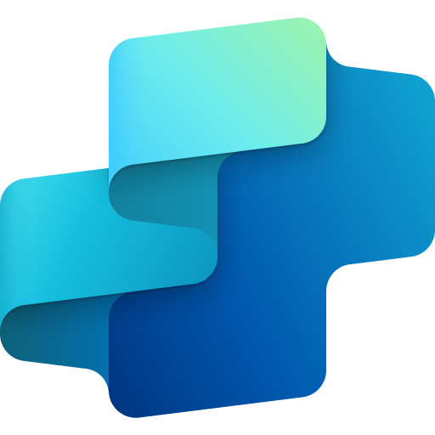

Build Agents
Build on Microsoft 365 Copilot
Build your own agent
Powerful simplicity
Advanced customization & flexibility
Declarative Agents
Custom Engine Agents
Microsoft 365 Copilot*
Microsoft 365 Copilot
Microsoft Teams*
Microsoft Teams
Deploy across
Web
New
+10 other channels
Build with
Copilot Studio
Visual Studio Code
Notes:
If you want to use Microsoft Copilot’s model and orchestrator, then you call it a declarative agent
And if you want to use your own model and orchestrator not dependent on Microsoft Copilot then you can call them Custom Engine agents, you are building up from scratch here whle in the declarative agent you are levering existing Microsoft Copilot cos you have already paid license for it. Now let me take you through declarative agents.
You can “extend” by adding your own agents on top of Microsoft 365 Copilot. That means the AI and orchestration is part of Microsoft 365 so you don’t need to worry about it. These are called Declarative agents.
Or you can “build” your own AI agents, called Custom engine agents. This is where Microsoft 365 presents your custom chatbot in the Bizchat UI. You control everything – and your responsible for it all as well – you might use AI models in Azure AI Studio along with your own code running in Azure app services.
These solutions can be developed by what we’re calling “pro devs” – the code jockeys among us – or using a low code tool called Copilot Studio.
I’m going to show you the Pro dev option using Visual Studio Code and a free extension called Teams Toolkit, however most of this can be developed with any tools that can create JSON and Zip files and create an HTTP web service.

Slide 12
User experience (optional)
Knowledge
Instructions and Grounding
Agents
Agent architecture
Skills
Actions, capabilities, triggers, workflows
Orchestrator
Autonomy
Planning, exceptions, self-learning
Foundation models
Notes:
They come in all shapes and sizes. But each agent is made up of the same components.
Agents anatomy consist of knowledge, skills, autonomous capabilities, orchestrator and foundational models.
Microsoft Copilot is one big agent behind the scenes.
Agents can call additional agents, referred to multi-agent workflows. For example, Microsoft 365 Copilot may call Copilot agents to bring new skills and knowledge.

Slide 13








Copilot extensibility models
Extend
Build
I want to use Copilot's orchestrator & models
I want to use orchestrator & models of my choice
Build extensions to Copilot for enterprise use for Microsoft 365
Build custom AI chatbots for Teams and Microsoft 365 apps
Declarative agents
Customized Microsoft Copilot with instructions, custom actions and knowledge
Custom engine agents
With Teams AI library
Tools
Plugins - To call your API (custom actions)
Pro code
VS Code or VS
Teams Toolkit
No or low code
Copilot Studio
Graph connectors - To ingest data (knowledge)
SharePoint & OneDrive (knowledge)
Web search(knowledge)

Slide 14
Copilot Agents
Declarative Agents
Custom Engine Agents
Ground responses
Bring actions
Custom workflows
Knowledge
Custom Actions
Your agents
Your business data
Your apps
Your business knowledge
OneDrive and SharePoint data
Your workflows
Your apps
Your automation
Your workflows
Your automation
Your model & orchestration
Notes:
First, you have the choice to extend Microsoft’s Copilot. I think about these options as “bringing your app to Microsoft’s AI.” Declarative Copilots , Connectors and Plugins fit this category well where partners declare knowledge sources & APIs and provide a set of instructions that Sydney will execute But of course, you also have the option of building your own copilot, which is the right side of this slide, where the partner can control the full orchestration E2E

Slide 15
I want to use Copilot's orchestrator & models
Extend
Declarative Agents
Custom Engine Agents
Ground responses
Bring actions
Custom workflows
Knowledge
Custom Actions
Your agents
Your business data
Your apps
Your business knowledge
OneDrive and SharePoint data
Your workflows
Your apps
Your automation
Your workflows
Your automation
PATH - E
Your model & orchestration
Notes:
First, you have the choice to extend Microsoft’s Copilot. I think about these options as “bringing your app to Microsoft’s AI.” Declarative Copilots , Connectors and Plugins fit this category well where partners declare knowledge sources & APIs and provide a set of instructions that Sydney will execute But of course, you also have the option of building your own copilot, which is the right side of this slide, where the partner can control the full orchestration E2E

Slide 16
User experience (optional)
Knowledge
Instructions and Grounding
Agents
Agent architecture
Skills
Actions, capabilities, triggers, workflows
Orchestrator
Autonomy
Planning, exceptions, self-learning
Foundation models
Notes:
Remember this diagram I showed you earlier. Now let’s see how that looks like for declarative agents.

Slide 17
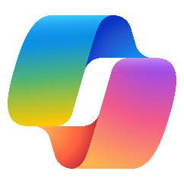
User experience
Knowledge
Instructions and Grounding
Agents
Instructions and Grounding
Declarative agents implementation
Skills
Actions, capabilities, triggers, workflows
Actions, capabilities
Orchestrator
Autonomy
Planning, exceptions, self-learning
Microsoft provided
Foundation models
Developer provided

Slide 18
I want to use orchestrator & models of my choice
Build
Declarative Agents
Custom Engine Agents
Ground responses
Bring actions
Custom workflows
Knowledge
Custom Actions
Your agents
Your business data
Your apps
Your business knowledge
OneDrive and SharePoint data
Your workflows
Your apps
Your automation
Your workflows
Your automation
Your model & orchestration
PATH - B
Notes:
First, you have the choice to extend Microsoft’s Copilot. I think about these options as “bringing your app to Microsoft’s AI.” Declarative Copilots , Connectors and Plugins fit this category well where partners declare knowledge sources & APIs and provide a set of instructions that Sydney will execute But of course, you also have the option of building your own copilot, which is the right side of this slide, where the partner can control the full orchestration E2E

Slide 19
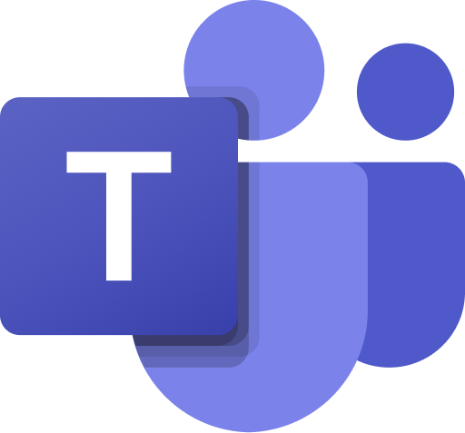

Microsoft Teams
Microsoft 365 Copilot
User experience (optional)
Knowledge
Instructions and Grounding
Agents
Agent architecture
Skills
Actions, capabilities, triggers, workflows
Orchestrator
Autonomy
Planning, exceptions, self-learning
Foundation models
Notes:
We believe organizations will create a wide range of agents, from the simplest that respond when you prompt them, to the most advanced that act autonomously and make their own dynamic plans
They come in all shapes and sizes. One thing to note, is that each agent is made up of the same components.
Agents anatomy consist of knowledge, skills, autonomous capabilities, orchestrator and foundational models.
Microsoft Copilot is one big agent behind the scenes.
Agents can call additional agents, referred to multi-agent workflows. For example, Microsoft 365 Copilot may call Copilot agents to bring new skills and knowledge.

Slide 20
User experience
Microsoft Teams
Microsoft 365 Copilot
Custom engine agents
Teams AI library implementation
Knowledge
Instructions and Grounding
Agents
Skills
Actions, capabilities, triggers, workflows
Orchestrator
Autonomy
Planning, exceptions, self-learning
Microsoft provided
Foundation models
Developer provided
Notes:
We believe organizations will create a wide range of agents, from the simplest that respond when you prompt them, to the most advanced that act autonomously and make their own dynamic plans
They come in all shapes and sizes. One thing to note, is that each agent is made up of the same components.
Agents anatomy consist of knowledge, skills, autonomous capabilities, orchestrator and foundational models.
Microsoft Copilot is one big agent behind the scenes.
Agents can call additional agents, referred to multi-agent workflows. For example, Microsoft 365 Copilot may call Copilot agents to bring new skills and knowledge.

Slide 21
Which AI do you want to use in your chat experience?
Extend
LLM built into Microsoft 365
Custom AI models LLM/SLM
Orchestration built into Microsoft 365
Custom planners for orchestration
Rich integration with Microsoft 365 built in
UI enhancements with Teams AI Library to have rich integration:
Feedback Loop
Generated by AI label
Sensitivity label
Customized citations
Build
Knowledge from Graph connectors and SharePoint + OneDrive
Paid through Microsoft 365 Copilot license
Declarative Agent
Path “E”
Custom Engine Agent
Path “B”
Notes:
Here are some of the tradeoffs between “extend”-ing and making a Declarative Agent vs, “build”-ing a Custom Engine Agent.

Slide 22
Where do I start?
Coders start here!
Add knowledge and skills
Bring your own
Which AI ?
Built into M365
Real time data
API Plugin
Path “E”
M365 Copilot provides
Yes
General
Declarative agent
Path “E”
Developer provides (Azure AI Studio or your choice of AI)
Static data w/ semantic grounding
Graph Connector
Custom engine agent
https://aka.ms/learn-gc-ts https://aka.ms/learn-gc-cs
Path “B”
Learn modules
Yes
Notes:
How do you decide if you want to Extend or Build, and which specific approach do you want to take? This and the next few slides will attempt to help you understand the options.
The “Path E” and “Path B” notes are there to tell about some hands-on labs we have in an online workshop called Copilot Developer Camp.
“Path B” is the “Build” path where you build a custom engine agent
“Path E” is the “Extend” path where you build a declarative agent and API plugin
And this is the first question… which AI do you want to use?

Slide 23
Where do I start?
Declarative agent
Path “E”
Build your first declarative agent
Start here!
Build an API
Bring your own
Use M365 Copilot’s orchestrator & models
M365 Copilot provides orchestrator and models
No
Yes
Build a declarative agent with plugin (custom actions) using the API
Build your first custom engine agent
Developer provides orchestrator and models (Azure AI Studio or your choice of AI)
Enhance plugin
Implement RAG
Enhance response cards
Enhance UI with Powered AI Kit
Add authentication
Custom engine agent
Add authentication
Path “B”
Add Graph connector
Add actions
Notes:
How do you decide if you want to Extend or Build, and which specific approach do you want to take? This and the next few slides will attempt to help you understand the options.
The “Path E” and “Path B” notes are there to tell about some hands-on labs we have in an online workshop called Copilot Developer Camp.
“Path B” is the “Build” path where you build a custom engine agent
“Path E” is the “Extend” path where you build a declarative agent and API plugin
And this is the first question… which AI do you want to use?

Slide 24

Custom engine agent
Copilot chat (Teams)
Application code
Teams AI Library
Bot Framework
Microsoft 365
LLM
Notes:
Here is a sample architecture for a custom engine agent.
Notice that Microsoft 365, shown in green, is providing the chat UI and installation services so end users and Microsoft 365 admins can work with your agent. It’s also providing access to Microsoft 365 data, if you need it, using the Graph API. Everything else is up to you!
Your app, shown in gold, is a REST API that uses the Azure Bot Framework. The Bot Framework supports channels – not to be confused with Teams channels! – for connecting chatbots to different applications such as Teams, Slack, or Facebook messenger. In this case it’s using the Microsoft 365 bot channel to communicate over BizChat.
Your app is likely to use the Bot Framework SDK to communicate with Bot Services, and the new Teams AI library to manage orchestration, actions, and prompts. The Teams AI library also enables a bot to access Bizchat features such as feedback (thumbs up/down), references, AI labelling in a way that’s consistent with all Copilot agents.
Your app is responsible for its own intelligence! In this example we have Azure AI services running an OpenAI model. Custom data is indexed using Azure Search and embedded using a text embedding model. The Copilot Camp lab leads you through creating all of this. But you could also use some other service or models of your choice.

Slide 25
Custom engine agent
Microsoft 365 App Installation
Application code
Copilot chat (Teams)
pkg
Bot Framework SDK
Teams AI Library
Bot Services Registration
Channel
Channel
Entra ID
Azure AI Services *
Bot Identity
gpt-4o
gpt-4 gpt-35-turbo
and more
text-embedding-ada-002
(required only for vector search)
Azure AI Search
App Identity
Data Sources (files, databases, etc.)
Completion model
Embedding model
Data sources
Notes:
Here is a sample architecture for a custom engine agent.
Notice that Microsoft 365, shown in green, is providing the chat UI and installation services so end users and Microsoft 365 admins can work with your agent. It’s also providing access to Microsoft 365 data, if you need it, using the Graph API. Everything else is up to you!
Your app, shown in gold, is a REST API that uses the Azure Bot Framework. The Bot Framework supports channels – not to be confused with Teams channels! – for connecting chatbots to different applications such as Teams, Slack, or Facebook messenger. In this case it’s using the Microsoft 365 bot channel to communicate over BizChat.
Your app is likely to use the Bot Framework SDK to communicate with Bot Services, and the new Teams AI library to manage orchestration, actions, and prompts. The Teams AI library also enables a bot to access Bizchat features such as feedback (thumbs up/down), references, AI labelling in a way that’s consistent with all Copilot agents.
Your app is responsible for its own intelligence! In this example we have Azure AI services running an OpenAI model. Custom data is indexed using Azure Search and embedded using a text embedding model. The Copilot Camp lab leads you through creating all of this. But you could also use some other service or models of your choice.

Slide 26

Declarative agent
Microsoft 365 BizChat (Copilot chat UI)
Microsoft 365 App Installation
Instructions
Capabilities
SharePoint
OneDrive
Graph Connectors
Web content
App Package
Microsoft 365 Copilot Orchestration and LLM
* Recommended but others can be used
Notes:
Declarative agents, on the other hand, are a lot simpler since all the AI and orchestration is handled by Microsoft 365.
At its simplest, a declarative agent is just some instructions in the app package. Declarative agents might also reference data in SharePoint, OneDrive, Graph connectors and web sites, but there’s no imperative code apart from commands you might put in the natural language instructions.

Slide 27

Declarative agent with API plugin
Microsoft 365 BizChat (Copilot chat UI)
Microsoft 365 App Installation
Instructions
Capabilities
Actions (API definitions)
pkg
REST API
Microsoft 365 Copilot Orchestration
and LLM
Application code
Microsoft
Graph API
Microsoft Graph SDK
Entra ID
Plugin Identity
App Identity
Notes:
If you add an API Plugin, then the Declarative Agent can call your API. You can write any app you want as long as it supports a standard HTTP REST API
You can instruct Copilot to authenticate to the API either on behalf of users via OAuth 2.0 or using a simple API key. Oauth 2.0 allows signing users into Entra ID, same as they are signed into Copilot, so you can access resources on their behalf.

Slide 28
Extend Microsoft Copilot
Build your own copilot
Common to both:
user experience
enterprise app catalog and app store
M365 admin experience
Copilot
Your copilot
Declarative agent
Custom engine agent
Graph Connectors
Azure Search
API Plugins
Azure AI Studio
Notes:
In the presentations that follow, we will dive deep on each of these options.
You will see how to build declarative agents, including API plugins, and custom engine agents using Azure Search and Azure AI Studio.
Something to keep in mind is that though these are very different approaches, end users and admins get the same experience for either one.
Humans are used to talking to experts and specialists of all sorts at work; adding some well chosen AI agents can make their work easier using this familiar paradigm.

Slide 29
https://aka.ms/CopilotDevCamp

Slide 30
Custom engine agent
Microsoft 365 App Installation
Application code
Copilot chat (Teams)
pkg
Bot Framework SDK
Teams AI Library
Microsoft 365
Bot Services Registration
Channel
Channel
Azure AI Services *
gpt-4o
gpt-4 gpt-35-turbo
and more
text-embedding-ada-002
(required only for vector search)
Azure AI Search
Entra ID
Data Sources (files, databases, etc.)
Bot Identity
App Identity
Completion model
Embedding model
Data sources
Notes:
Here is a sample architecture for a custom engine agent.
Notice that Microsoft 365, shown in green, is providing the chat UI and installation services so end users and Microsoft 365 admins can work with your agent. It’s also providing access to Microsoft 365 data, if you need it, using the Graph API. Everything else is up to you!
Your app, shown in gold, is a REST API that uses the Azure Bot Framework. The Bot Framework supports channels – not to be confused with Teams channels! – for connecting chatbots to different applications such as Teams, Slack, or Facebook messenger. In this case it’s using the Microsoft 365 bot channel to communicate over BizChat.
Your app is likely to use the Bot Framework SDK to communicate with Bot Services, and the new Teams AI library to manage orchestration, actions, and prompts. The Teams AI library also enables a bot to access Bizchat features such as feedback (thumbs up/down), references, AI labelling in a way that’s consistent with all Copilot agents.
Your app is responsible for its own intelligence! In this example we have Azure AI services running an OpenAI model. Custom data is indexed using Azure Search and embedded using a text embedding model. The Copilot Camp lab leads you through creating all of this. But you could also use some other service or models of your choice.

Slide 31
Custom engine agent
Microsoft 365 BizChat (Copilot chat UI)
Microsoft 365 App Installation
REST API
pkg
Bot Framework SDK
Application code
Microsoft Graph API
Bot Services Registration
Microsoft Graph SDK
Channel
Teams AI Library
Application prompts
Channel
Entra ID
Azure AI Services *
Azure Search Service
Bot Identity
gpt-4o, gpt-4, or gpt-35-turbo
text-embedding-ada-002 (required only if vector search is needed)
App Identity
Data Sources (files, databases, etc.)
Legend
Microsoft 365 Service
Azure Services
Microsoft provided library
Your application
Completion model
Embedding model
Data sources
Notes:
Here is a sample architecture for a custom engine agent.
Notice that Microsoft 365, shown in green, is providing the chat UI and installation services so end users and Microsoft 365 admins can work with your agent. It’s also providing access to Microsoft 365 data, if you need it, using the Graph API. Everything else is up to you!
Your app, shown in gold, is a REST API that uses the Azure Bot Framework. The Bot Framework supports channels – not to be confused with Teams channels! – for connecting chatbots to different applications such as Teams, Slack, or Facebook messenger. In this case it’s using the Microsoft 365 bot channel to communicate over BizChat.
Your app is likely to use the Bot Framework SDK to communicate with Bot Services, and the new Teams AI library to manage orchestration, actions, and prompts. The Teams AI library also enables a bot to access Bizchat features such as feedback (thumbs up/down), references, AI labelling in a way that’s consistent with all Copilot agents.
Your app is responsible for its own intelligence! In this example we have Azure AI services running an OpenAI model. Custom data is indexed using Azure Search and embedded using a text embedding model. The Copilot Camp lab leads you through creating all of this. But you could also use some other service or models of your choice.

Slide 32
Declarative agent
Microsoft 365 BizChat (Copilot chat UI)
Microsoft 365 App Installation
Instructions
Capabilities
SharePoint
OneDrive
Graph Connectors
Web content
App Package
Microsoft 365 Copilot Orchestration and LLM
Legend
Microsoft 365 Service
Azure Services
Microsoft provided library
Your application
* Recommended but others can be used
Notes:
Declarative agents, on the other hand, are a lot simpler since all the AI and orchestration is handled by Microsoft 365.
At its simplest, a declarative agent is just some instructions in the app package. Declarative agents might also reference data in SharePoint, OneDrive, Graph connectors and web sites, but there’s no imperative code apart from commands you might put in the natural language instructions.

Slide 33
Graph Connector
Microsoft 365 BizChat (Copilot chat UI)
Semantic Index Microsoft Graph storage
Microsoft Graph API
Microsoft 365 Copilot Orchestration and LLM
Your application
Application code
Microsoft Graph SDK
Legend
Microsoft 365 Service
Azure Services
Microsoft provided library
Your application
Notes:
Another option is to create a Graph Connector. In this case your application uses the Graph API to push some data into Microsoft 365, where it is indexed and used directly by Microsoft 365 Copilot.
This works well but it’s read-only and it depends on your application keeping the data up-to-date; it’s not real time..

Slide 34
Extend Microsoft Copilot
Build your own copilot
Copilot
Your copilot
Declarative agent
Custom engine agent
Graph Connectors
Azure Search
API Plugins
Azure AI Studio
Notes:
In the presentations that follow, we will dive deep on each of these options.
You will see how to build declarative agents, including API plugins, and custom engine agents using Azure Search and Azure AI Studio.

Slide 35
Which AI do you want to use in your chat experience?
LLM and orchestration are built into Microsoft 365
Rich integration with Microsoft 365 built in
Paid through Microsoft 365 Copilot license
Extend
Custom AI models from Azure AI Studio
Custom prompt, orchestration, RAG implementations with Teams AI library
UI enhancements:
Feedback Loop
Generated by AI label
Sensitivity label
Customized citations
Build
Declarative Agent
Path “E”
Custom Engine Agent
Path “B”
Notes:
Here are some of the tradeoffs between “extend”-ing and making a Declarative Agent vs, “build”-ing a Custom Engine Agent.

Slide 36
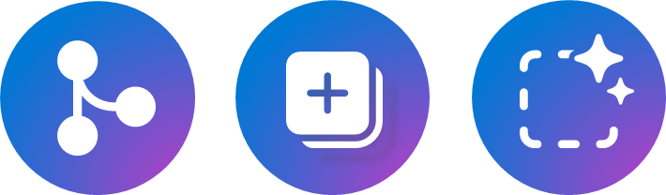
Anatomy of an Agent
Workflow instructions
Triggers
Actions
Knowledge
Orchestrator
Foundational Models
Notes:
Workflow instructions drive the right outcomes and desired responses from copilot, and can include guidelines on how copilot should behave, its scope, and functionalities. – While controlled by DC prompts – For custom engine copilots, controlled by underying planning
Triggers help copilot take reactive, proactive actions and facilitate automation. While M365 Copilot responds to user prompt today, you can build your own agentic workflows with proactive messages through CEC path Actions are tasks copilot can perform on your behalf, from real-time data lookups to executing changes and updates on behalf of the user.
Knowledge is the information copilot can reason over to answer user prompts. Powered by RAG techniques, copilots can expand their native semantic understanding beyond the source data used for their training to provide relevant, contextual responses.
Orchestrator oversees and synchronizes pre and post processing of the user prompt across foundation models, knowledge and actions.
Foundation models are AI models that can perform a wide range of tasks, from language processing, visual comprehension, text generation, code writing and more.

Slide 37
Microsoft 365 Copilot Options
Copilot Agents
Adopt
Extend
Build
IA, user training, etc.
Declarative Agents
Custom Engine Agents
Notes:
You may have seen this graphic – going all the way back to last year’s Ignite in November 2023.
Dona Sarkar showed this slide and pointed out three ways to work with Copilot.
- You can “adopt” it and use all the features out of the box. User training and good information architecture can help people get the most out of it.
There are also two main options for adding agents to Copilot.

